Slide 1

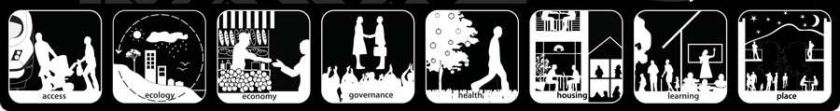
Year 7

Slide 2

'Liveability' - the qualities of a place (city, town, suburb, neighbourhood) that contribute to the quality of life experienced by residents and others.

Slide 3
Brainstorm – what makes a place a good place to live?

Slide 4
What makes a place liveable? We have to consider the factors below:
Environmental
Infrastructure
Cleanliness, dust, pollution, noise, air and water quality,
personal security, traffic safety, community identity and pride.
historic structures, architectural styles, streetscapes
streets, public transport, health, shopping centres, etc
Economic
Value of property
Social
Cultural

Slide 5




Most & Least ‘Liveable’ Cities
http://www.telegraph.co.uk/travel/10270269/The-worlds-most-liveable-cities-2013.html?frame=2654758
http://www.telegraph.co.uk/travel/travelnews/10270633/The-worlds-least-liveable-cities-2013.html
IMAGES

Slide 6
The most liveable city in the world??

Slide 7
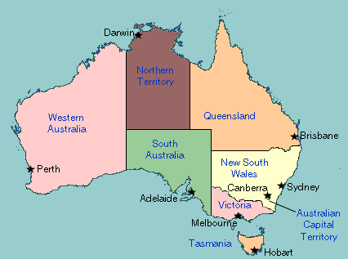
Hint: it is in Australia…

Slide 8
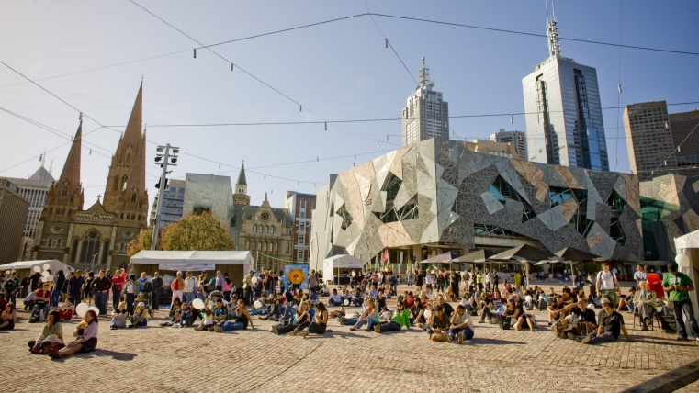
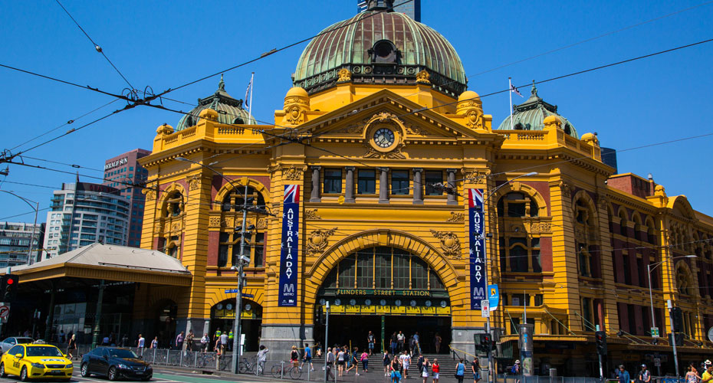
Melbourne
https://www.youtube.com/watch?v=tcrXW1WMvNs

Slide 9
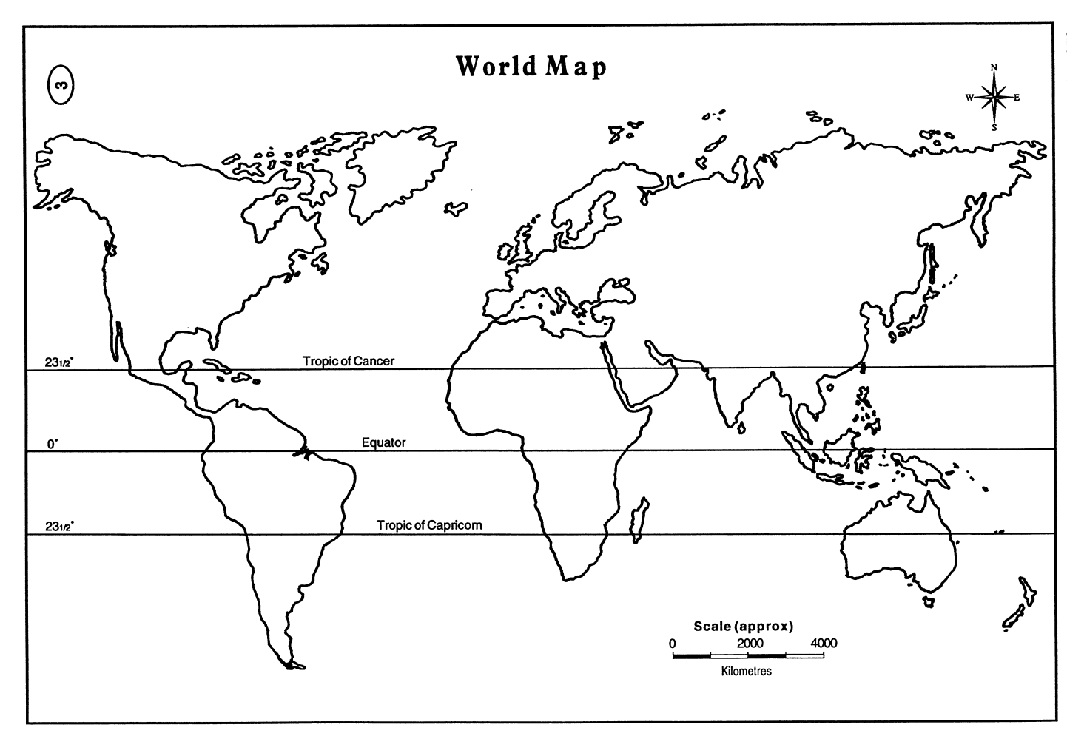

Mapping the
Most & Least ‘Liveable’ Cities

Slide 10

Bangladesh
Legend
Melbourne
Liveable
Unliveable
‘Liveability’

